Slide 1
Meta-Analysis
By
Catherine Connelly

Slide 2
Agenda
Choosing a topic
Finding articles
Deciding on potential moderators
Calculating effect sizes
Calculating moderators
Limitations
Future directions

Slide 3
Choosing a topic
Central tendency description
  What is the mean level of satisfaction among temporary workers?
Pre-post contrasts
  How did workers’ life satisfaction levels change before and after temporary employment?
Group contrasts
  Experimental or clinical trials research
  OR: Are temporary workers more satisfied than permanent employees?
Association between variables
  What is the correlation between temporary workers’ commitment to their agencies and their commitment to their clients?

Slide 4
In your assignment:
Provide an overview of the topic that you have chosen.
  Why is it important? Why is it interesting?
Define the variables that you are using, and note any important debates in the field
  e.g., how to measure “commitment”, what is a temporary worker, magnitude of relationships, etc.
Explain that no meta-analyses of your topic have been done (or that none have been done recently).

Slide 5
Finding articles
You should have EVERY relevant article (census, not a sample), therefore:
  Find qualitative review articles on your topic
  Databases
    use a variety
    Keep track of the search terms that you have used (e.g., temporary AND commitment, contingent AND commitment, temporary AND loyalty, etc.)
  Try to find “special topics” issues
  Look for conference presentations and proceedings
  Contact authors for unpublished work
  *** Check the bibliography of every article ***

Slide 6
In your assignment:
Describe the process you used to find articles
Explain any necessary restrictions (e.g., since the introduction of a new technology, research instrument, etc.)
k ≥ 15 is a general rule of thumb, but the more articles the better!

Slide 7
Making the most of the articles that you have found
Not every article will have a nice correlation table with N, alphas, etc.
Look for “r” substitutes:
  beta if there is only one variable
  beta if this is the first step in hierarchical regression
  A path coefficient in SEM (if no other IVs affecting that DV)

Slide 8
Making the most of the articles that you have found
Do you have enough information to calculate r?
  Independent t-test and sample sizes for each group?
  F-ratio from a one-way ANOVA and sample sizes for each group?
  Chi-square with df = 1 and total sample size?
  t-value testing the statistical significance of r?
Notes:
R=(t/(t^2+n1+n2-2)^1/2)
R=(F/(F^2+n1+n2-2)^1/2)
R=(chi-square/N)^1/2
R=t/(t^2+df)^1/2

Slide 9
Making the most of the articles that you have found
What if the n is not shown for the pair of variables that I am interested in?
What if I am interested in a subset of a measure that is used in the article?
  e.g., affective organizational commitment
What if the article doesn’t report the reliabilities for the scales that were used?

Slide 10
Deciding on potential moderators
What explains variation in findings?
Code everything that might be relevant
  Methodological issues
    Measures
      Supervisory ratings of OCBs or self-reports?
    Definitional issues
      Young workers = < 21? < 18? < 30?
      Contingent worker = temporary? Part-time?
  Context
  Rigor
What are the advantages of checking for moderators?

Slide 11
In your assignment:
Develop and briefly justify a hypothesis regarding at least one moderator
Be as specific as possible
  Explain the way in which the moderator will affect the relation between x and y
  Or
  Explain how the two groups will differ
Do not just state “this will moderate the effect of x on y”

Slide 12
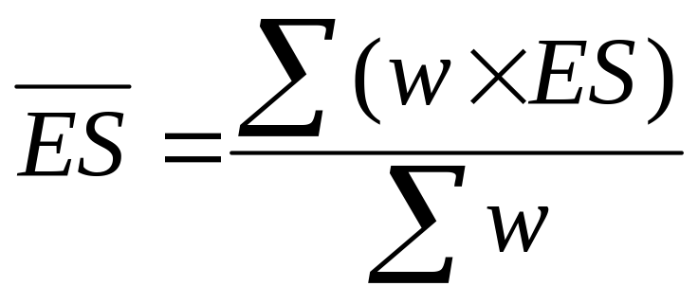
Calculating effect sizes
Correlations
The basic formula is:
BUT
You need to take into account the sample size (n) as well as the reliabilities (alphas) of the two measures

Slide 13
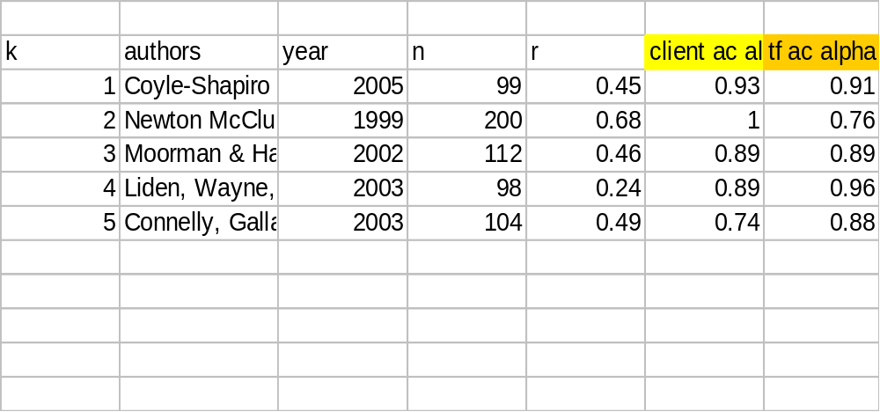
For your assignment:
Notes:
The colored parts are Alpha for the variables for which we are gathering the r

Slide 14
Five Steps
i) correct the effect sizes for unreliability
ii) transform effect sizes to standard scores
iii) weight the effect sizes
iv) calculate the overall weighted mean effect size
v) convert the overall weighted mean back into unstandardized form.

Slide 15
i) Correct ES for unreliability:
Corrected r_{xy} = r_{xy} / sqrt(r_{xx} r_{yy})
So if:
r_{xy} = .45
r_{xx} = .93
r_{yy} = .91
Then r’_{xy} = ?
Notes:
Rxx and Ryy are alphas

Slide 16
Another example:
Newton McClurg (1999)
  n = 200
  r = .68
  reliability of temp firm commitment = .76
  no reliability given on client commitment (why?)
ES’ = ES_{r} / sqrt(r_{xx} r_{yy})
= .68/ sqrt(.76*1)
= .78

Slide 17
Correct ES for unreliability:
Study | n | ES | Alpha x | Alpha y | ES’
1 | 99 | .45 | .93 | .91 | .49
2 | 200 | .68 | 1 | .76 | .78
3 | 112 | .46 | .89 | .89 | .52
4 | 98 | .24 | .89 | .96 | .26
5 | 104 | .49 | .74 | .88 | .61

Slide 18
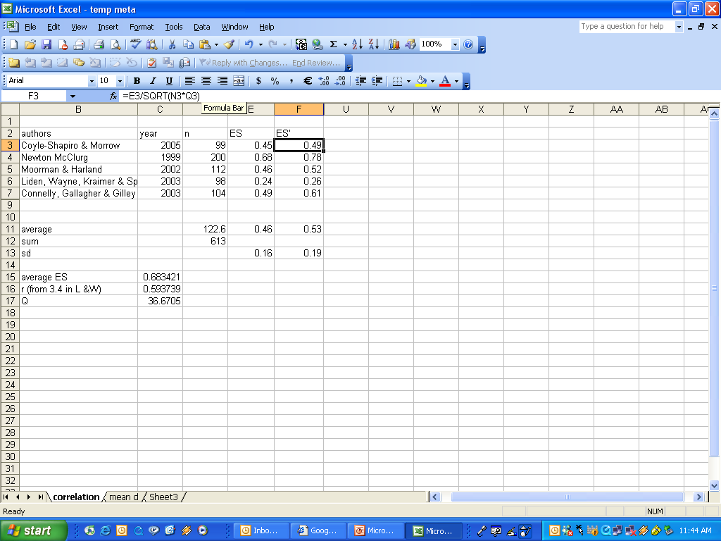

Slide 19
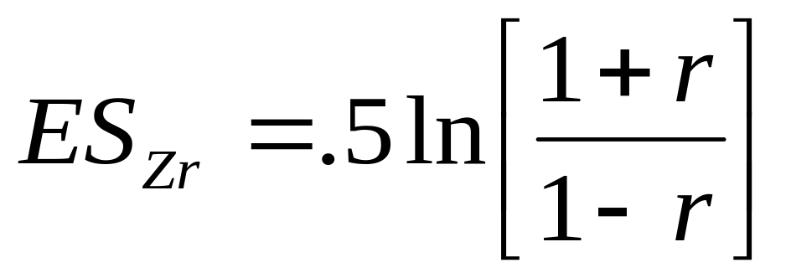
ii) transform r to Z
The unstandardized corrected r has a problematic standard error formulation (Alexander et al., 1989; Rosenthal, 1994), so we transform it:

Slide 20
For example:
=.5ln (( 1 + .44)/(1 - .44))
=.5ln ( 2.57)
= .53

Slide 21
Standardize the ES’
Study | n | ES | α x | α y | ES’ | ES’_{z}
1 | 99 | .45 | .93 | .91 | .44 | .53
2 | 200 | .68 | 1 | .76 | .78 | 1.05
3 | 112 | .46 | .89 | .89 | .52 | .57
4 | 98 | .24 | .89 | .96 | .26 | .27
5 | 104 | .49 | .74 | .88 | .61 | .70

Slide 22
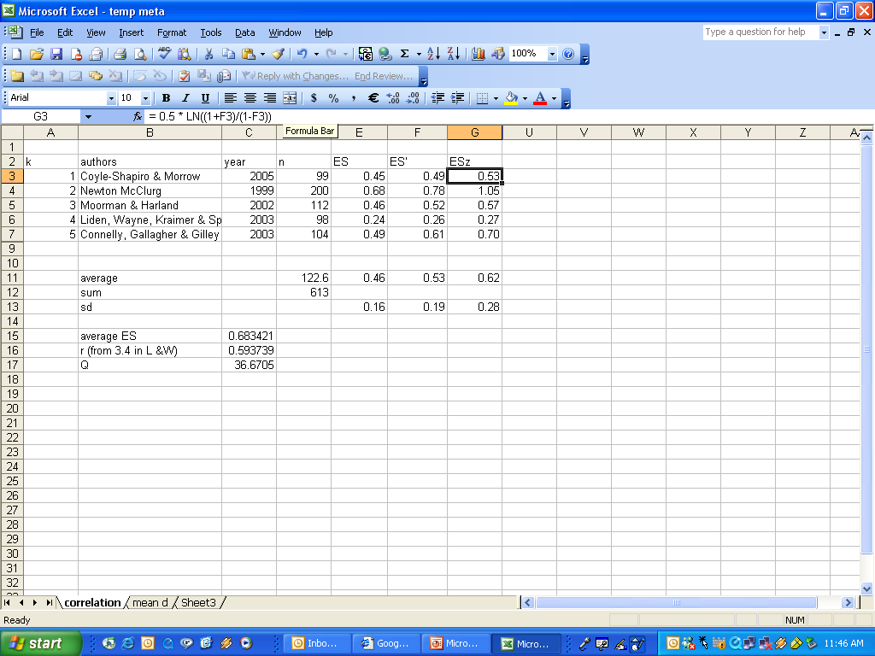

Slide 23
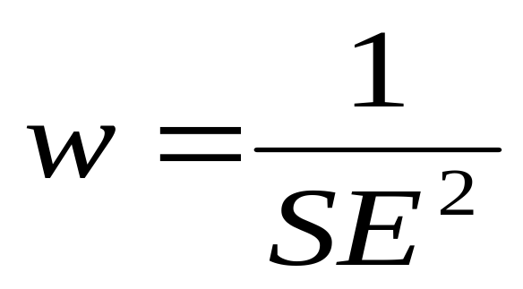
iii) weight results
The standard error (SE) is a direct index of ES precision.
The smaller the SE, the more precise the ES.
Hedges’ showed that the optimal weight for meta-analysis is:

Slide 24
Weight results (two steps)
The weight (w) for the transformed r (Z_{r}) is simply:
  n-3
However, because r was corrected for unreliability, then w also needs to be adjusted to w’ or:
w’ = w(r_{xx})(r_{yy})
  = (99 – 3) (.93)(.91) = 81.24

Slide 25
Weight results :
k | n | ES | α x | α y | ES’ | ES’_{z} | w | w’
1 | 99 | .45 | .93 | .91 | .44 | .53 | 96 | 81.24
2 | 200 | .68 | 1 | .76 | .78 | 1.05 | 197 | 149.72
3 | 112 | .46 | .89 | .89 | .52 | .57 | 109 | 86.34
4 | 98 | .24 | .89 | .96 | .26 | .27 | 95 | 81.17
5 | 104 | .49 | .74 | .88 | .61 | .70 | 101 | 65.77

Slide 26
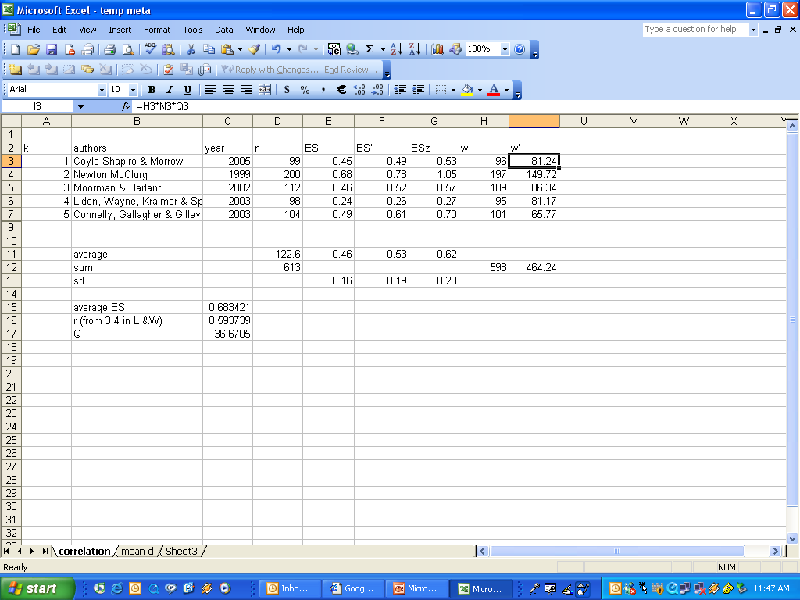

Slide 27
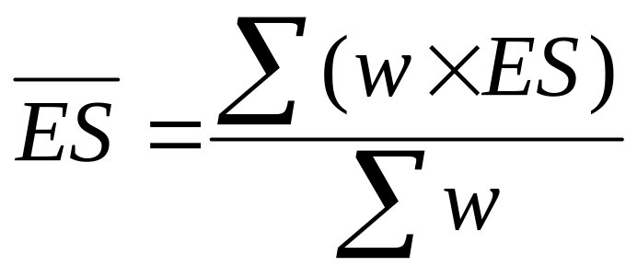
iv) Calculate the Overall (Weighted Mean) Effect Size
Recall:

Slide 28
Find the overall effect size :
k | ES’ | z | w | w’ | w’*ES’_{z}
1 | .44 | .53 | 96 | 81.24 | 43.46
2 | .78 | 1.05 | 197 | 149.72 | 156.52
3 | .52 | .57 | 109 | 86.34 | 49.39
4 | .26 | .27 | 95 | 81.17 | 21.57
5 | .61 | .70 | 101 | 65.77 | 46.34
Σ |  |  |  | 464.24 | 317.27
Calculate the product
Of these two calculations
Sum the two columns

Slide 29
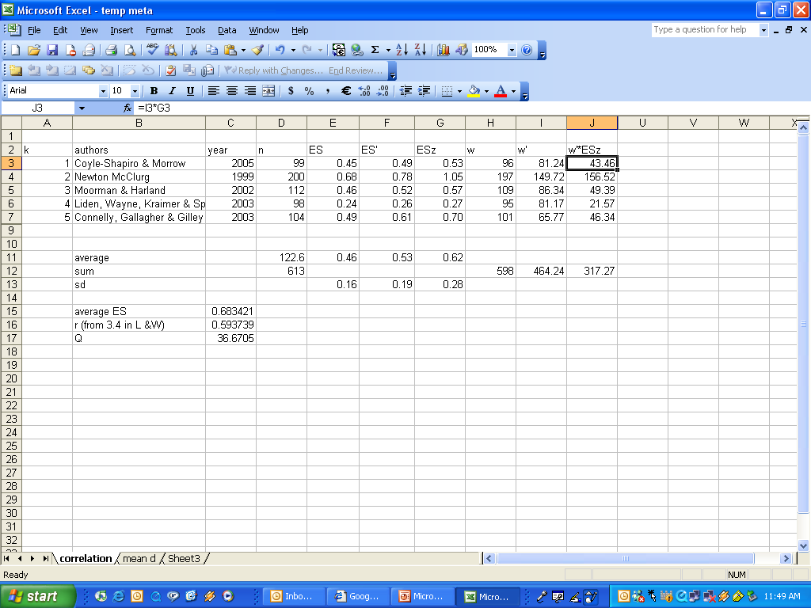

Slide 30

Calculate the Weighted Mean Effect Size
Recall:
= 317.27 / 464.24
= .68

Slide 31
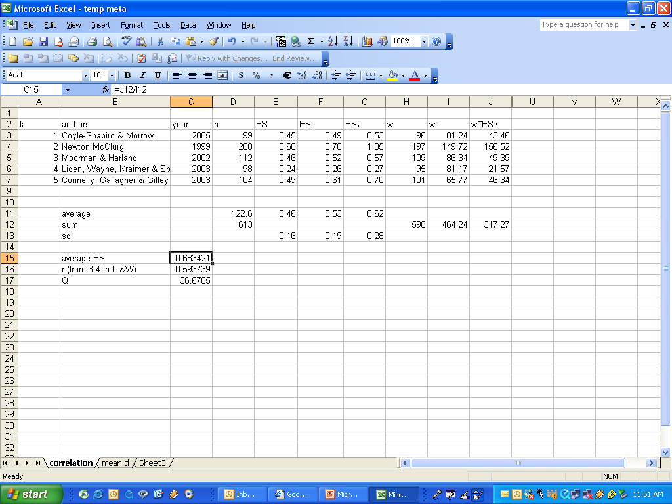

Slide 32
v) transform the overall average back into r
The overall average can be converted back into “r” with the inverse Z_{r} transformation:
r = (e^{2ESz} – 1)/(e^{2ESz} + 1)
= .59
In excel, the formula is:
=(EXP(2*C15) -1)/(EXP(2*C15)+1)

Slide 33
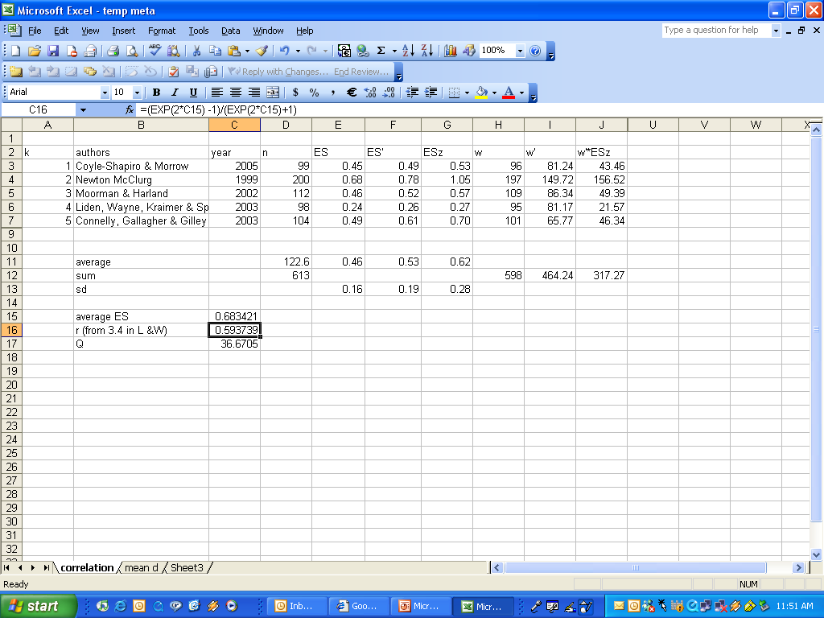

Slide 34
Are you interested in Mean Differences?
The process is similar:
i) correct the effect sizes for unreliability
ii) transform the effect sizes to standard scores ONLY IF you have very small sample sizes
iii) weight the effect sizes
iv) calculate the overall weighted mean difference effect size.
Notes:
Very small sample sizes: <30

Slide 35
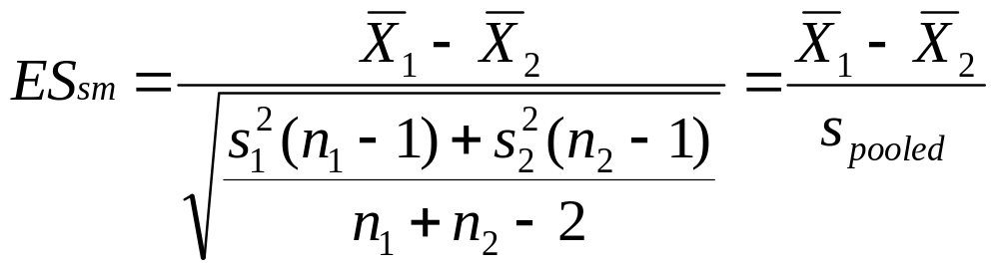
Calculate the effect size
But you may not have s _{pooled}
_{(s is the standard deviation)}
In Excel the formula is (something like):
=(K3-N3)/SQRT(((D3-1)*L3*L3+(D3-1)*O3*O3)/(D3+D3-2))

Slide 36
For example
k | n | Mean 1 | Sd 1 | Mean 2 | Sd 2 | ES
1 | 99 | 3.52 | 1.72 | 3.3 | 1.55 | .13
2 | 200 | 3.33 | .98 | 3.64 | .83 | -.34
3 | 112 | 3.12 | .81 | 3.2 | .82 | -.10
4 | 98 | 4.1 | 1.33 | 3.91 | 1.73 | .12
5 | 104 | 4.58 | 1.58 | 3.43 | 1.61 | .72

Slide 37
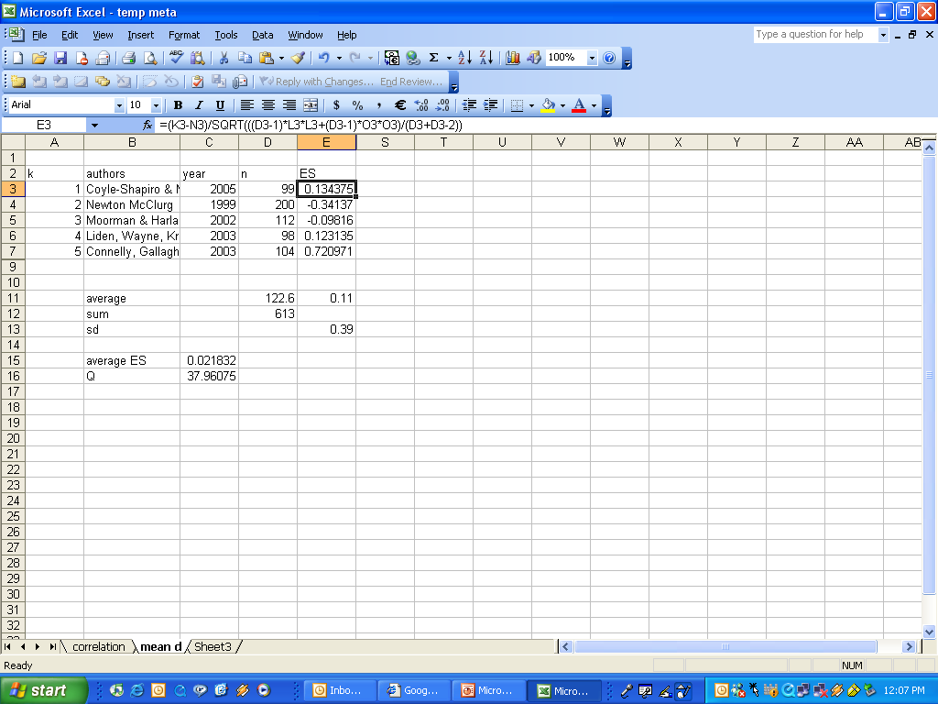

Slide 38
i) Correct for unreliability
  ES’ = ES_{sm} / sqrt( r_{xx})*sqrt ( r_{yy})
  ES_{sm} represents the standardized mean difference
  r_{xx} represents the reliability for satisfaction
  r_{yy} represents the reliability for satisfaction

Slide 39
For example
k | n | Mean 1 | Mean 2 | ES | ES’
1 | 99 | 3.52 | 3.3 | .13 | .15
2 | 200 | 3.33 | 3.64 | -.34 | -.39
3 | 112 | 3.12 | 3.2 | -.10 | -.11
4 | 98 | 4.1 | 3.91 | .12 | .13
5 | 104 | 4.58 | 3.43 | .72 | .89

Slide 40
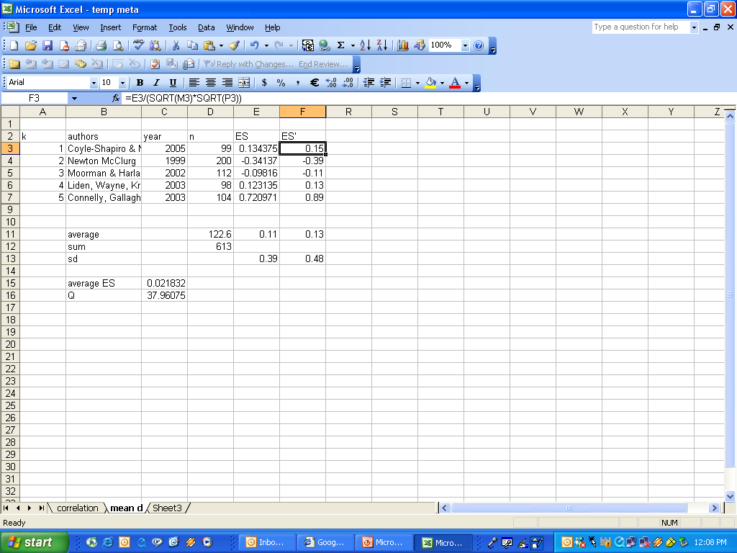

Slide 41
iii) Weight the effect sizes
=(2n₁n₂ (n₁ + n₂))/2(n₁ + n₂)² + n₁n₂ES’²)
BUT don’t forget to correct the weighting for unreliability
w’ = w(r_{xx})(r_{yy})

Slide 42
For example
k | n | Mean 1 | Mean 2 | ES | ES’ | w | w’
1 | 99 | 3.52 | 3.3 | .13 | .44 | 49.36 | 41.78
2 | 200 | 3.33 | 3.64 | -.34 | .78 | 98.12 | 149.72
3 | 112 | 3.12 | 3.2 | -.10 | .52 | 55.91 | 44.29
4 | 98 | 4.1 | 3.91 | .12 | .26 | 48.89 | 41.77
5 | 104 | 4.58 | 3.43 | .72 | .61 | 47.28 | 30.79

Slide 43
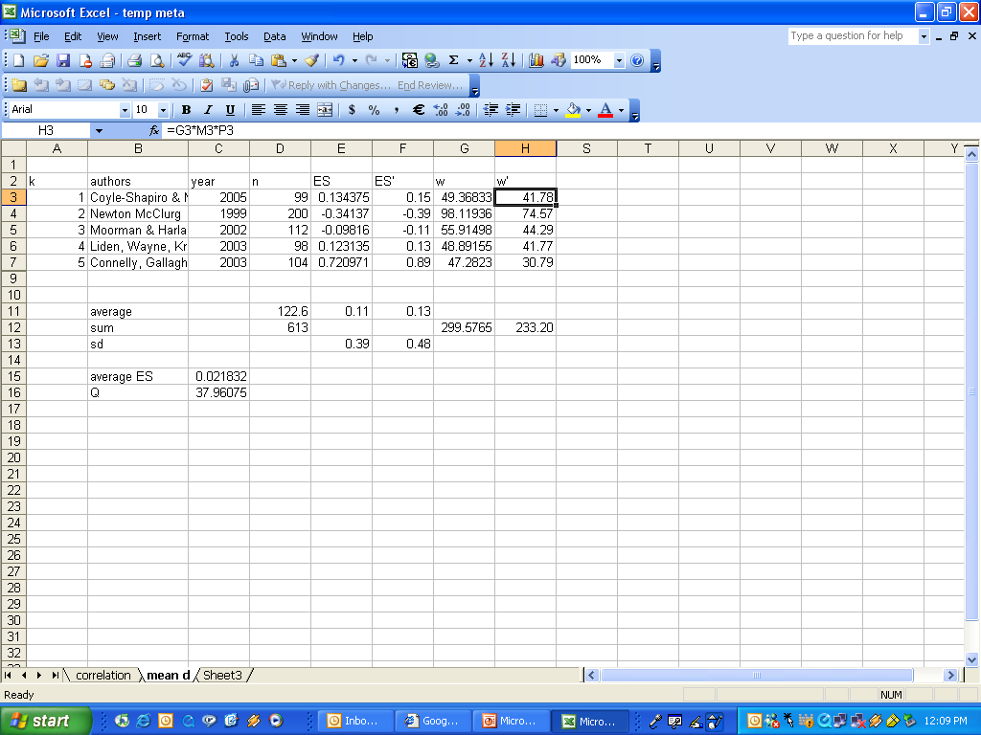

Slide 44
iv) Calculate the overall weighted mean difference effect size
Use the same formula and process as before:

Slide 45
For example
k | ES’ | w | w’ | w’*ES_{z}
1 | .44 | 49.36 | 41.78 | 6.10
2 | .78 | 98.12 | 149.72 | -29.20
3 | .52 | 55.91 | 44.29 | -4.88
4 | .26 | 48.89 | 41.77 | 5.56
5 | .61 | 47.28 | 30.79 | 27.51
Σ |  |  | 233.20 | 5.09
= 5.09 / 233.20
= .02
Are you surprised?

Slide 46
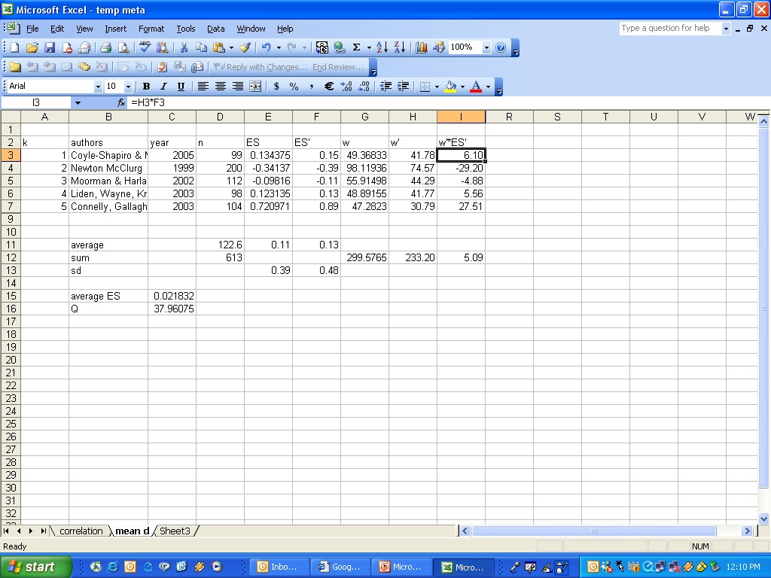

Slide 47
In your assignment:
Describe how you followed all the above steps
  Choose only one effect size
Show all your work, in an Appendix.
Discuss the implications of your effect size
  Correlations
    small = 0.10
    medium = 0.25
    large = 0.40
  Mean differences
    small = 0.20
    medium = 0.50
    large = 0.80

Slide 48
Confidence Intervals
What is the range within which the population mean is likely to be?
  e.g., 95% confidence interval of .05 to .49
Good way to show the precision of the results
Check to see if the confidence interval includes zero
  If not, then you know that you have a significant effect, at p < (1 – the CI)

Slide 49
Calculating Confidence Intervals
Calculate upper and lower bounds:
  Calculate the standard error of the mean
  Calculate the critical value from the z-distribution (e.g., 1.96 if α = .05)
  Multiply these together, and subtract OR add from/to the average effect size
  Use these formulas:
In our example:
ES = .02 ± 1.96 x √ 1/233.2
= .02 ± .13

Slide 50
Significance of
Confidence Intervals
You can also compute an exact significance level of the effect size
Calculate a z-score, where z = average effect size divided by the standard error of the average effect size
z = |ES|
SE
= .02 / √ 1 / 233.2
= .30

Slide 51
What about the moderators?
“Q” tests whether the assumption that all of the effect sizes are estimating the same population mean is a reasonable assumption
if rejected, the distribution of effect sizes is assumed to be heterogeneous.
Q looks at the “spread-out-ed-ness” of effect sizes:

Slide 52
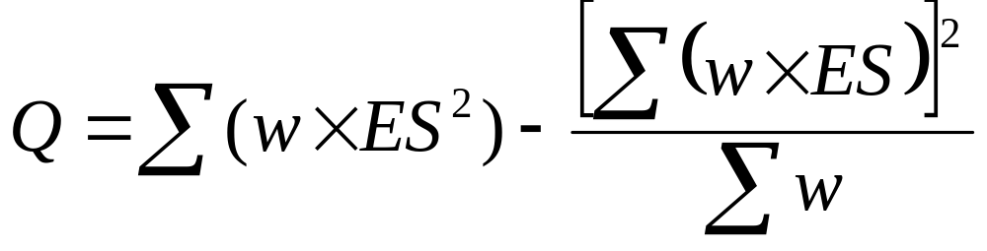
Moderators
Q is distributed as a X²
d.f. = number of effect sizes - 1

Slide 53
Moderators
k | ES’ | ES’_{z} | w | w’ | w’*ES_{z}’ | w’*ES_{z}’²
1 | .44 | .53 | 96 | 81.24 | 43.46 | 23.25
2 | .78 | 1.05 | 197 | 149.72 | 156.52 | 163.62
3 | .52 | .57 | 109 | 86.34 | 49.39 | 28.25
4 | .26 | .27 | 95 | 81.17 | 21.57 | 5.73
5 | .61 | .70 | 101 | 65.77 | 46.34 | 32.64
Σ |  |  |  | 464.24 | 317.27 | 253.50

Slide 54
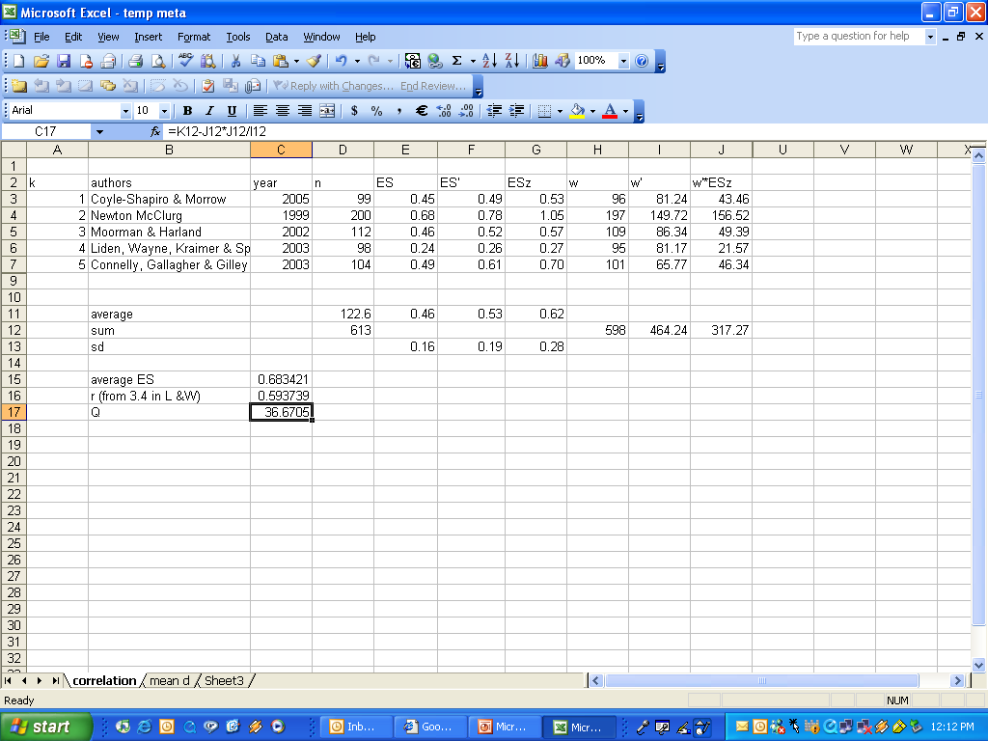

Slide 55
Moderators
Calculating Q:
Use the three sums that we have just generated:
Σw = 464.24
Σ(w’*ES_{z}’) = 317.27
Σ(w’*ES_{z}’² )= 253.50
Q = 253.50 – 317.27²/464.24
= 36.67
But what does that mean?

Slide 56
Moderators
Recall that Q is distributed like Chi-squared, with d.f. = k – 1
The critical value of Chi-squared with p < .05 and 4 d.f. is 9.49 (check a stats text or website)
Therefore, our Q of 36.67 exceeds the critical value, suggesting that our effect sizes are heterogeneous
Why would it be heterogeneous?

Slide 57
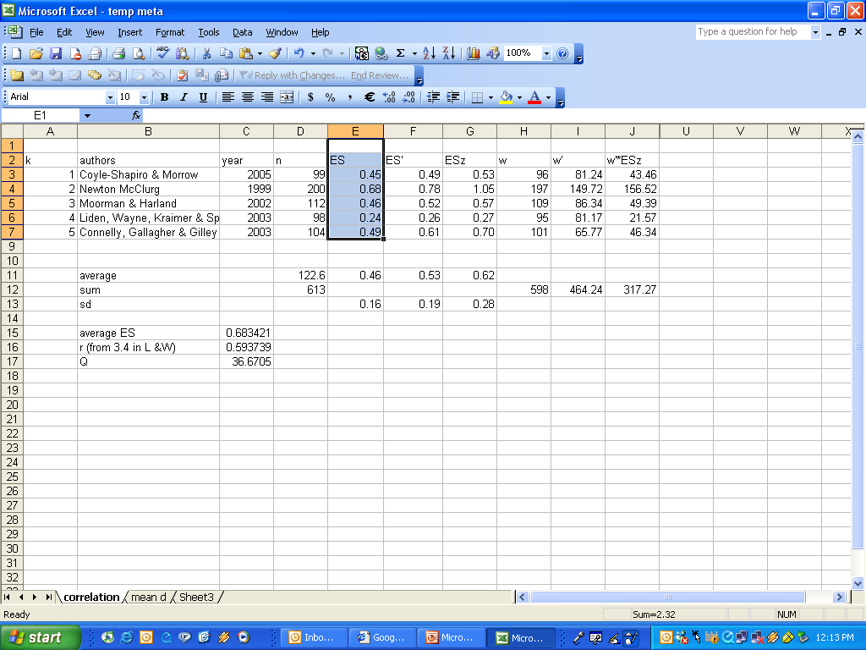

Slide 58
In your assignment
Calculate Q and report if it is significant or not
No matter what the results are, take the next step of checking for moderators.

Slide 59
Moderators
Analyze excess between-study variability
  for your project, examine categorical variables that you have coded, such as:
    type of measure,
    type of participant/organization,
    Quality of the study, etc.

Slide 60
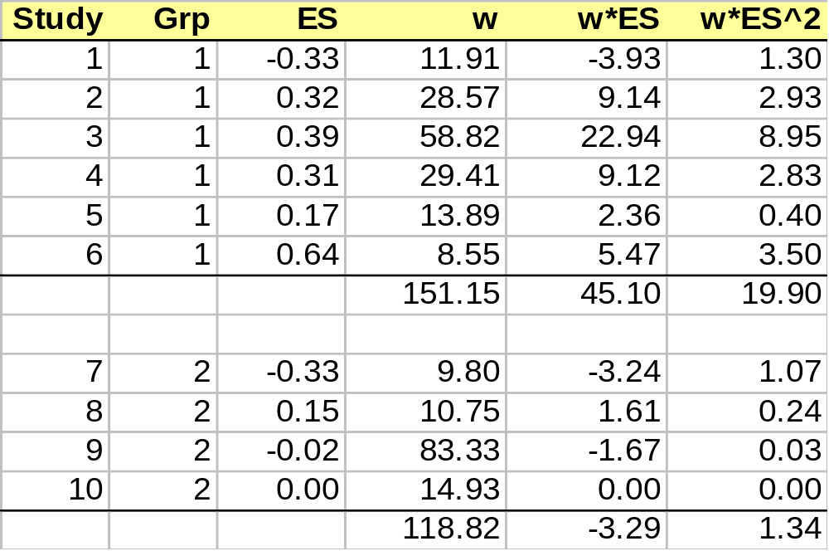
Moderators
Data is from Lipsey & Wilson 2001

Slide 61
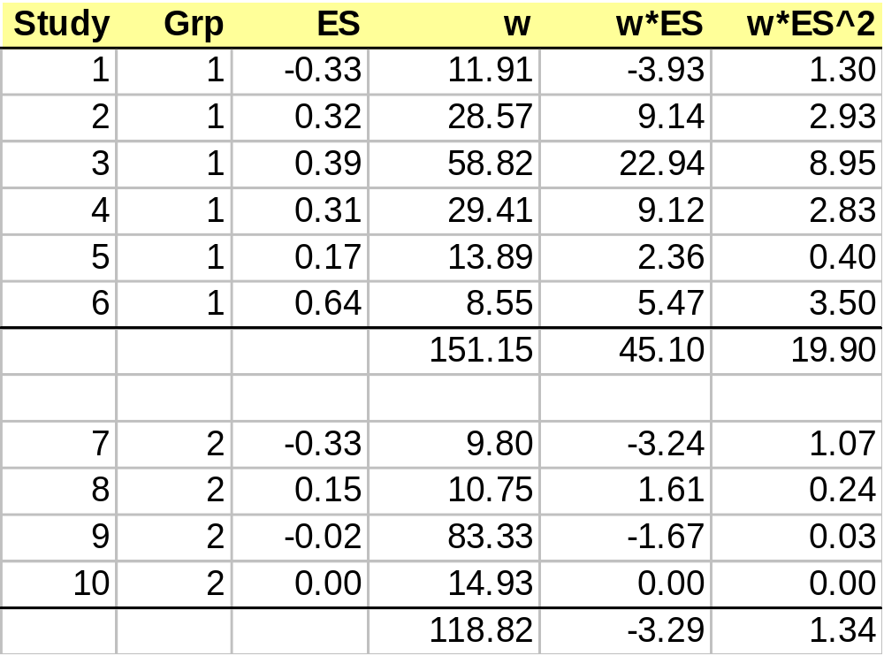
Moderators
1 - divide into
groups
2 – recalculate
the ES and Q
stats for each
group

Slide 62
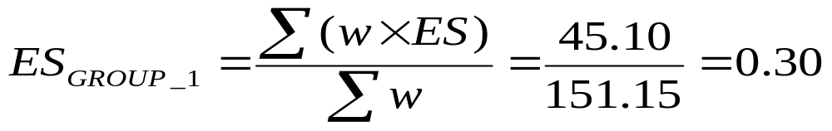

Moderators
Q₁ = 6.44, with d.f. = 5
Q₂ = 1.25, with d.f. = 3

Slide 63
In your assignment
Report the results of your hypothesized moderators: accept or reject?
  Effect sizes of each group
  Q statistic for each group

Slide 64
Limitations
Missing data
No qualitative data
“File drawer” problem
“Apples and oranges”: Missing moderators
  Survey context
  Measurement differences
  Methodological quality
    Exclude certain studies
    GIGO
Notes:
“file drawer” problem= unpublished studies which are usually ignored.
GIGO: garbage in, garbage out

Slide 65
In your assignment:
Acknowledge all the limitations of your study
Describe how you addressed them
Make suggestions for future research

Slide 66
After your assignment…
More Variables!
Regression
  You can combine many meta-analytic results and run a regression
  Use DSTAT or another software program to correct the standard errors of the regression coefficients
SEM
  You can also run an SEM analysis (the procedure is similar)

